Slide 1

Task 2:
Requirement Gathering
Project Title:
Design and Implementation of a Mobile App for Collection of QoE Data from Mobile Network Subscribers

Slide 2
Introduction
Building on the principles of Requirement Engineering, Elicitation was a key activity in this phase.
Stakeholders were engaged to uncover their actual needs, expectations, and pain points. grounded in real-world insights from those who would interact with it most.

Slide 3
Internal Stakeholders (Development Team): UI/UX Designers, Software Developers, Project Managers
Stakeholder Identification
01
Stakeholders refer to anyone involved in, impacted by, or can directly influence the project.
2. External Stakeholders (End Users) : Mobile Network Subscribers
02
3. Key External Stakeholders (Mobile Network Providers ) : Examples: Orange, MTN Cameroon, Camtel.
03
4. Tertiary Stakeholders (Indirect Influence) : Regulatory authorities, Academic Researchers, Investors or Sponsors.
04

Slide 4
Stakeholder Engagement Strategy
Methods and communication practices used to involve stakeholders in the project at the right level and frequency
Software developers | Weekly meetings and clear task allocation
Project manager | Project planning and monitoring
UI/UX designers | Conduct user research to design user-friendly interfaces
End users | App onboarding and providing feedback reviews
Mobile network providers | Data-sharing agreements and providing the network service
Regulatory authorities | Provide access to final reports and compliance updates
Academic researchers | Optional data-sharing agreements under license terms.

Slide 5

Requirement Gathering Techniques
The different techniques employed in the gathering of requirements for the development of the QoE (Quality of Experience) Mobile App include:
Document Analysis
Surveys and Questionnaires
Stakeholder Interviews (Network Providers)
Brainstorming Sessions

Slide 6
I. Document Analysis
Paper Title: Modeling the Customer Experience Using Machine Learning for Optimizing the Performance of Telecommunications Networks. By Binele Abana et al. 2024
Influence on Current Project:
QoS vs. QoE differences, Mean Opinion Score, Signal Strength, and Call drop rate evaluation metrics.
These parameters enable us to evaluate better performance matrices to be considered, relating technical teams and end-users.
II. Surveys and Questionnaires
III. Stakeholder Interviews
(Network Providers)
MTN Cameroon, Orange
IV. Brainstorming Sessions
Within Development Team(developers)

Slide 7
Data Gathering
This involved gathering feedback about the QoE from users of MTN, Orange and Camtel Comeroon.
Types of Data Collected
Quantitative Data (e.g Satisfaction Ratings)
Qualitative Data (e.g alternate behaviors to network issues)
Data Collection Methodology
Direct Interview approach
Exisiting QoE Service Review (By Network Providers)
Customer Service Calls,
Whatsapp communications,
Word of Mouth feedback
Walk-in Complaints
End-User Questionnaire:
Network choice and usage frequency
Problem Statement
Affinity to App
App functioning concerns.... etc

Slide 8

Key Findings
Low overall network usage satisfaction
Frequent Connectivity Issues arise
Common Frustrations include : Unreliable connections, Slow speeds, Expensive services.
Coping behaviors are Toggling Airplane mode, Network Switching, Location changing.
Existing QoE feedback methods are challenged with data validity concerns, hence causes false provider perceptions of their QoS

Slide 9
Data Cleaning
The effectiveness of any data-driven application lies in the quality of its data, obtained through Data cleaning.
This process involved:
Initial Data Review
Data Entry (Manual Entry, Digital Export)
Data Consolidation

Slide 10
Data Cleaning Process
Tools Used: Python (For automation and scalable cleaning) ,
Microsoft Excel (Manual inspections and corrections)
01
02
Handling Missing Values
Using Pandas Library functions
e.g df.isnull().sum() , isinstance(x, str) else False).sum(),filla()
Standardizing Text Entries
Using NumPy Library functions e.g pd.to_numeric()
03
Removing duplicates
df.duplicated().sum() to identify duplicate records

Slide 11
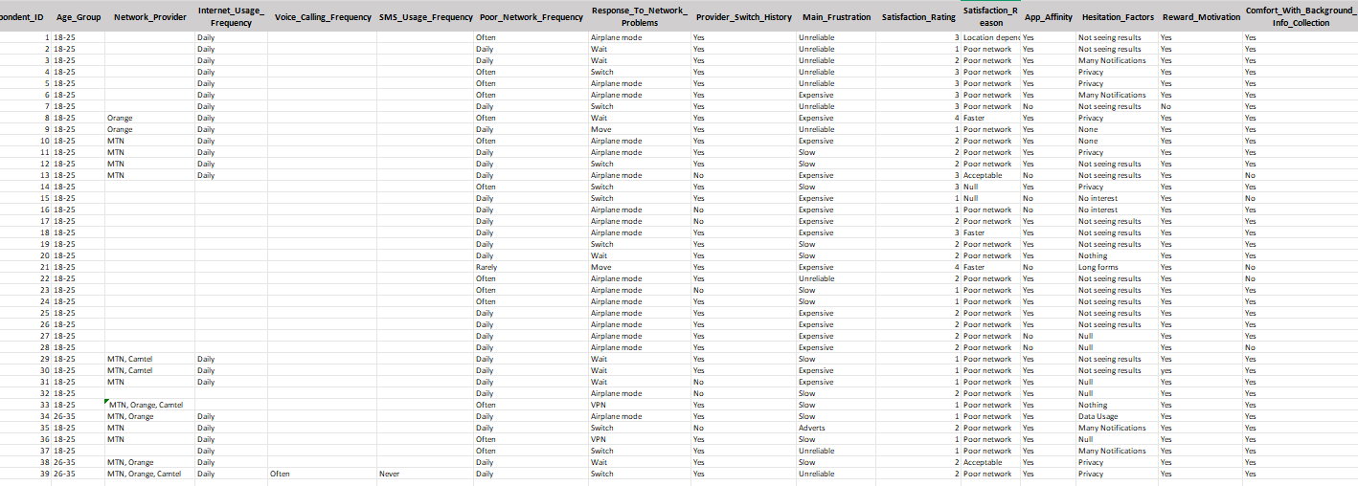
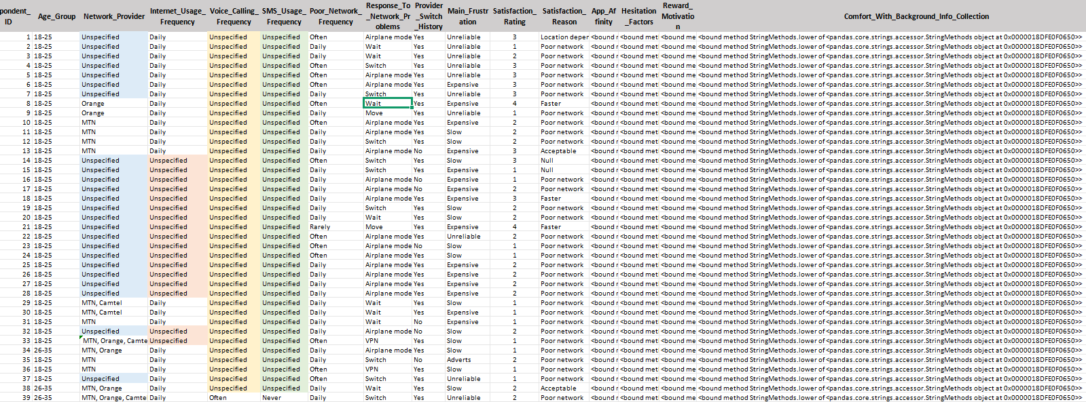
Data Cleaning Results

Slide 12
User Reluctance Accessment
01
Privacy Concerns
Hesitation exhibited by potential users towards technological solution
Technical and Design Barriers
02
Trust Deficit with Network Operators
03
Resource Consumption
concerns
04

Slide 13
User-Reluctance Mitigation
Addressing Privacy Concerns
Transparent data policies
Granular permissions
Collection scheduling
Anonymous reporting
Overcoming Technical Barriers
Minimalist interface
Reduced form fields
One-tap feedback
Lightweight design
Addressing Resource Consumption
Data-saver mode
Compact design
Resource monitoring
Offline functionality
Building Trust and Credibility
Pulic results
Community partnership
Operaator commitments

Slide 14
Incentive Approaches
Micro-rewards
Tiered benefits
Recognition systems

Slide 15
Conclusion
Elicitation was conducted as part of the Requirement Engineering process.
It involved direct engagement with stakeholders of the system.
Focus was on uncovering real needs, expectations, and challenges.
The insights guided informed and user-centered system design.

Slide 16
Thank You for Listenig....

